Slide 1

PROJECT ON
Global EV Sales Analysis
Presented by:
Sk. Sameer
K. Hemanth
Batch no: 456

Slide 2
Agenda
Introduction / Global EV Market Overview
Business Problem
Types of Electric Vehicles
Regional and Category Trends
Powertrain & Mode Insights
Parameter and Unit Analysis
Time Series & Comparative Analysis
Conclusion and Recommendations

Slide 3
Introduction:-
Electric Vehicles (EVs) are becoming an important part of transportation across the world.
As fuel prices increase and pollution becomes a serious concern, many countries are moving towards electric vehicles as a cleaner and more affordable option.
This project studies global electric vehicle data to understand how EV usage is growing in different regions.
It looks at the types of electric vehicles, their usage patterns, and how trends have changed over time.
India has started adopting electric vehicles rapidly, with increasing awareness, government support, and growing charging infrastructure.

Slide 4
Business Problem:-
How can automotive companies and policymakers understand global EV trends by region, vehicle type, and powertrain to make better decisions on production, sales strategy, and infrastructure planning?
As we see a lot of problems we are facing regarding the services of Ev, We saw recent clashes of Ola service centers there is no services provided properly as we just started adopting the Ev.
Without data-driven insights into sales performance, usage patterns, and service challenges, companies risk losing customer trust, slowing EV adoption, and facing operational inefficiencies.

Slide 5
Types of Electric Vehicles
BEV (Battery Electric Vehicle): Runs fully on electricity and does not use petrol or diesel.
PHEV (Plug-in Hybrid Electric Vehicle): Uses both electricity and fuel, and can be charged using a plug.
HEV (Hybrid Electric Vehicle): Uses fuel along with a small electric motor but does not need external charging.
FCEV (Fuel Cell Electric Vehicle):Uses hydrogen to produce electricity and releases only water as emission.

Slide 6
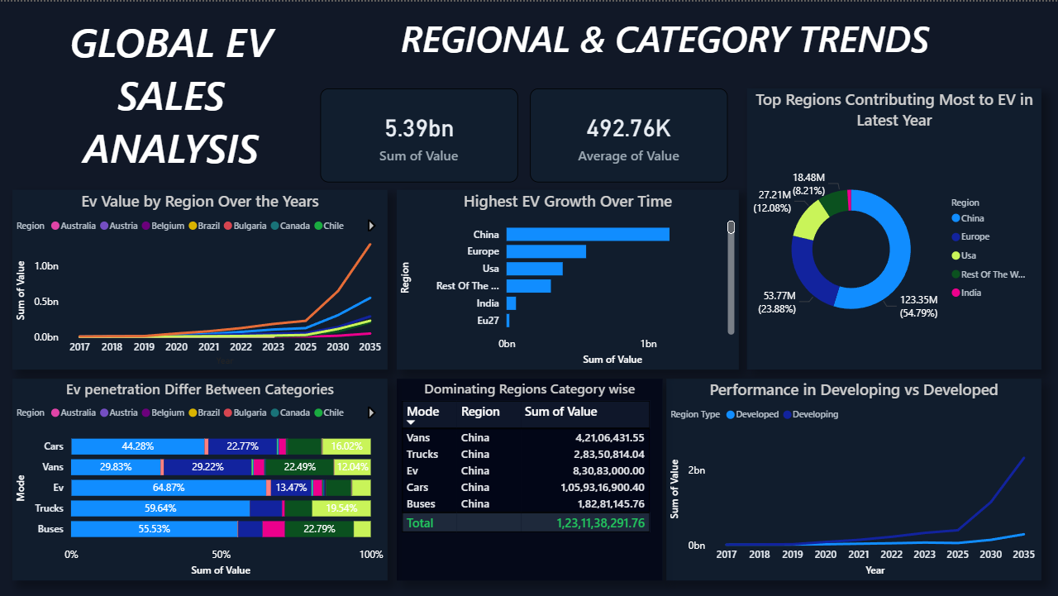
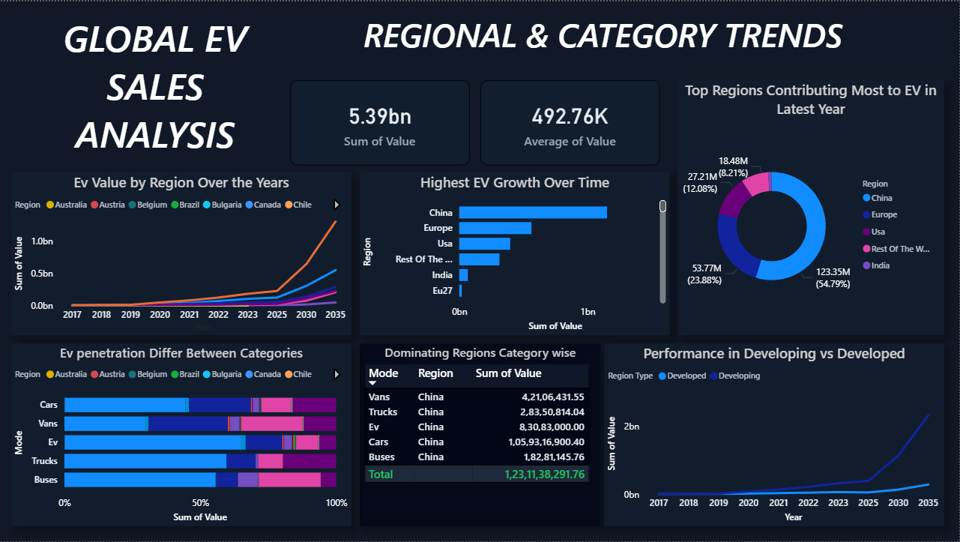
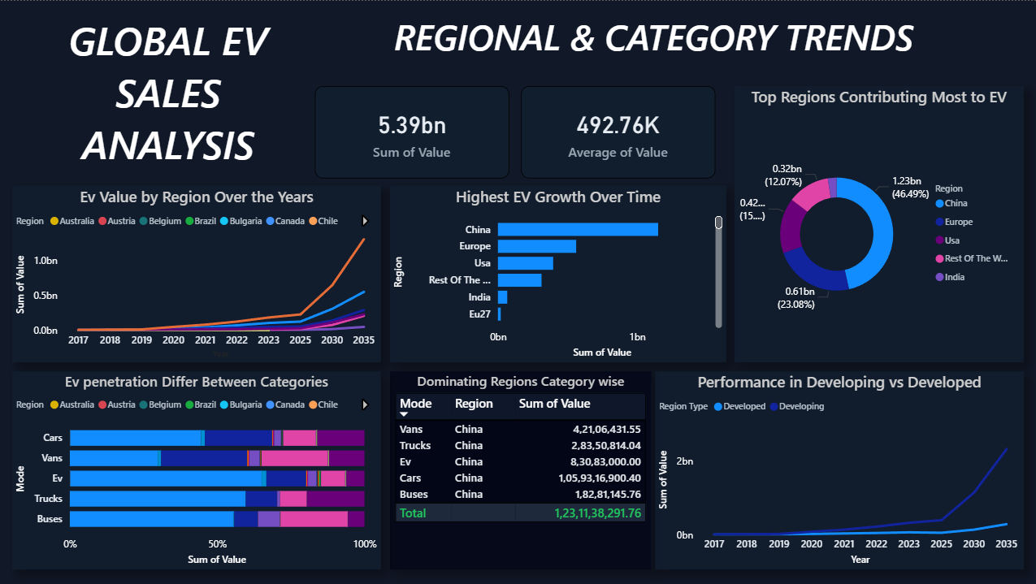

Slide 7
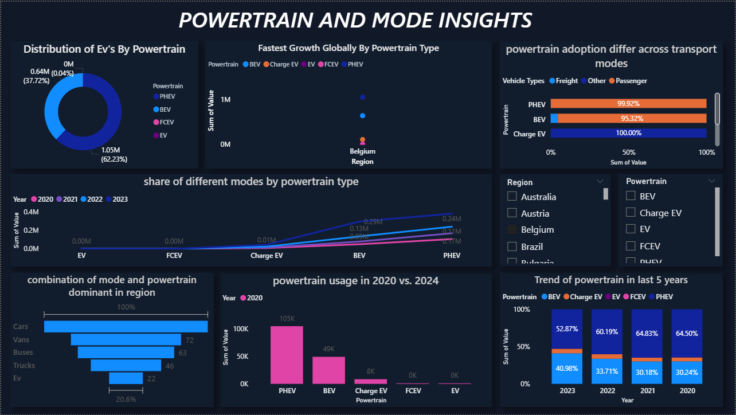
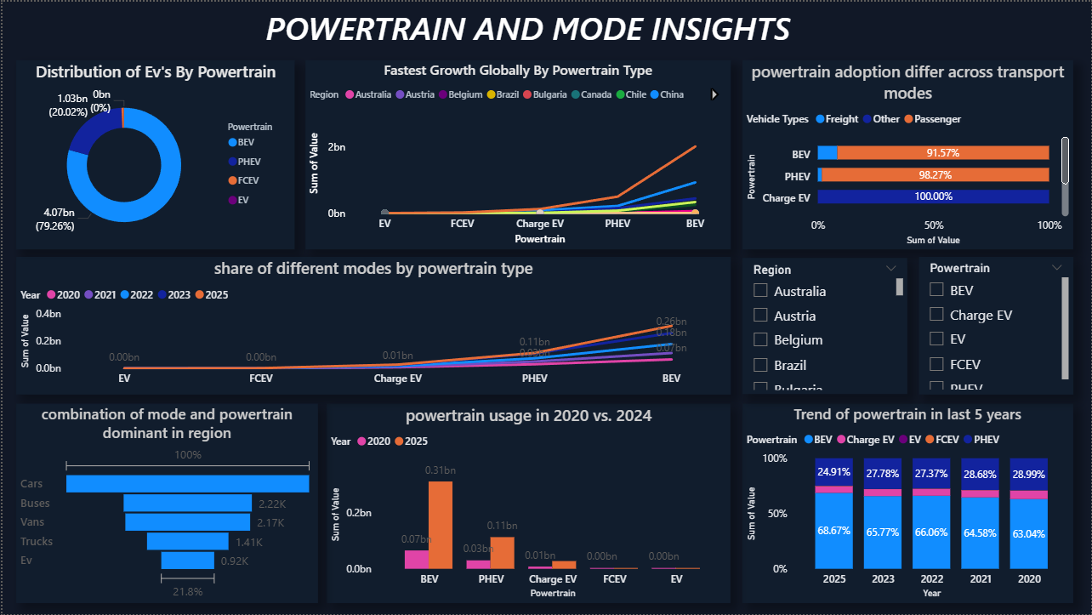
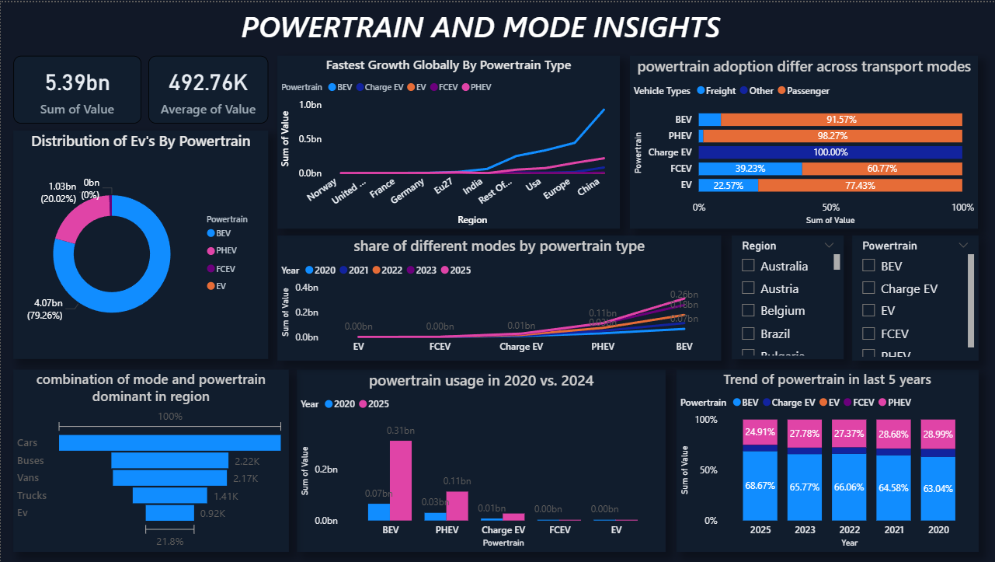


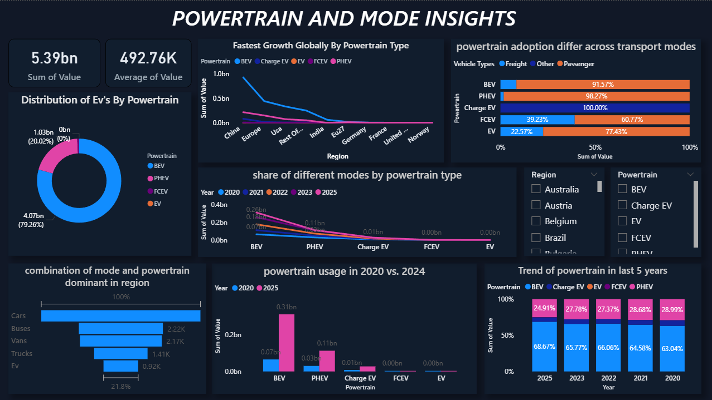

Slide 8
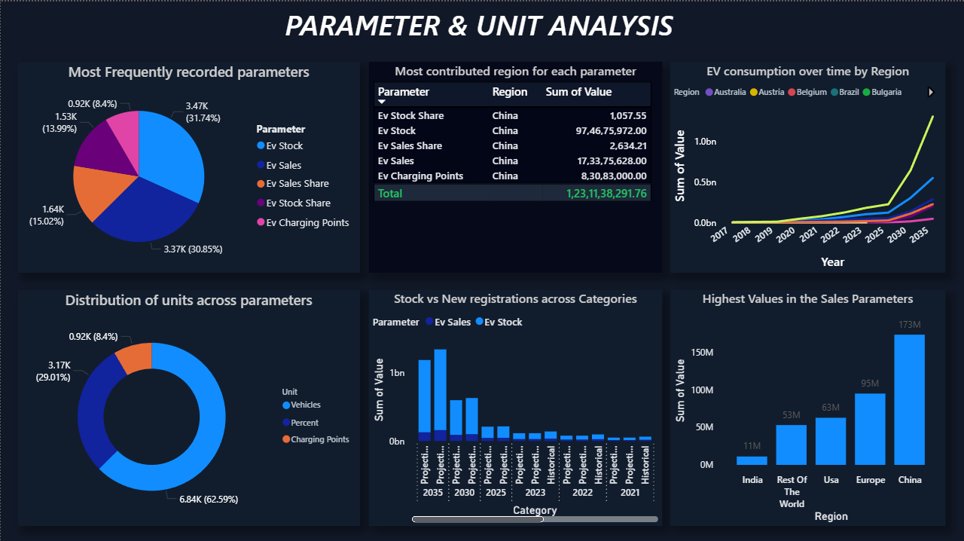
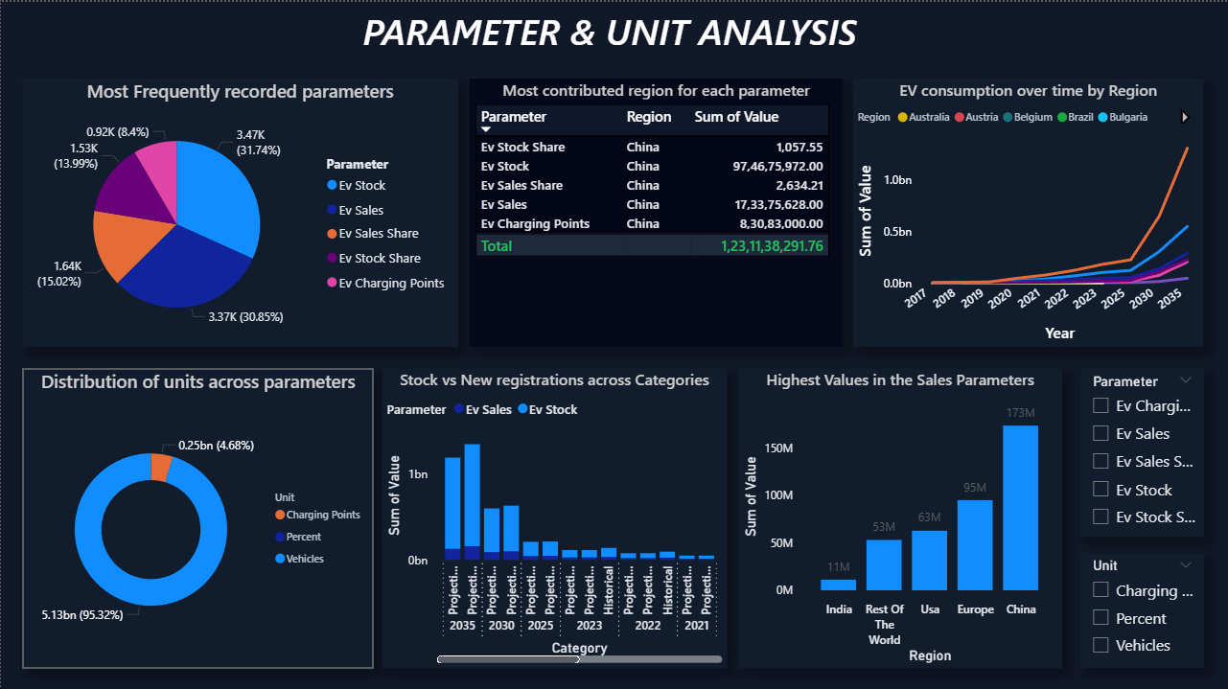

Slide 9
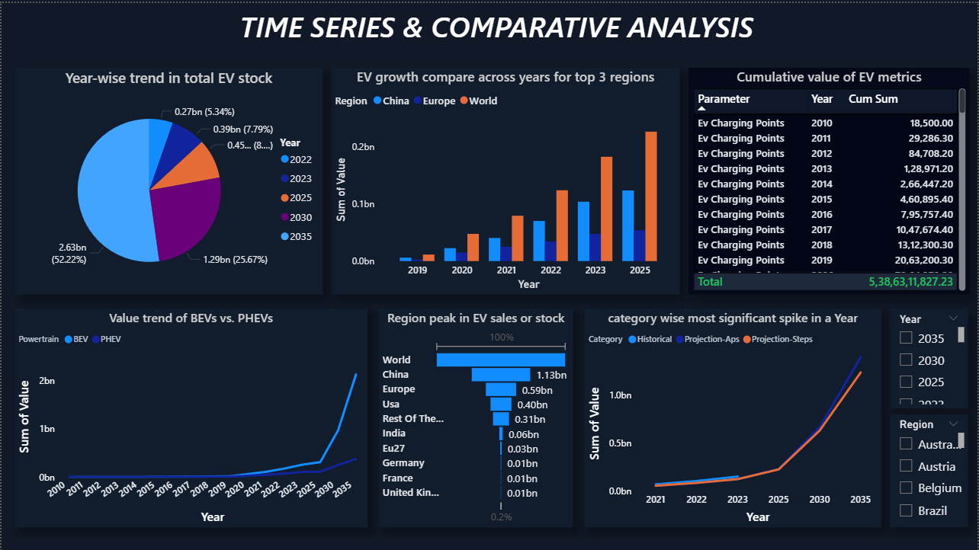
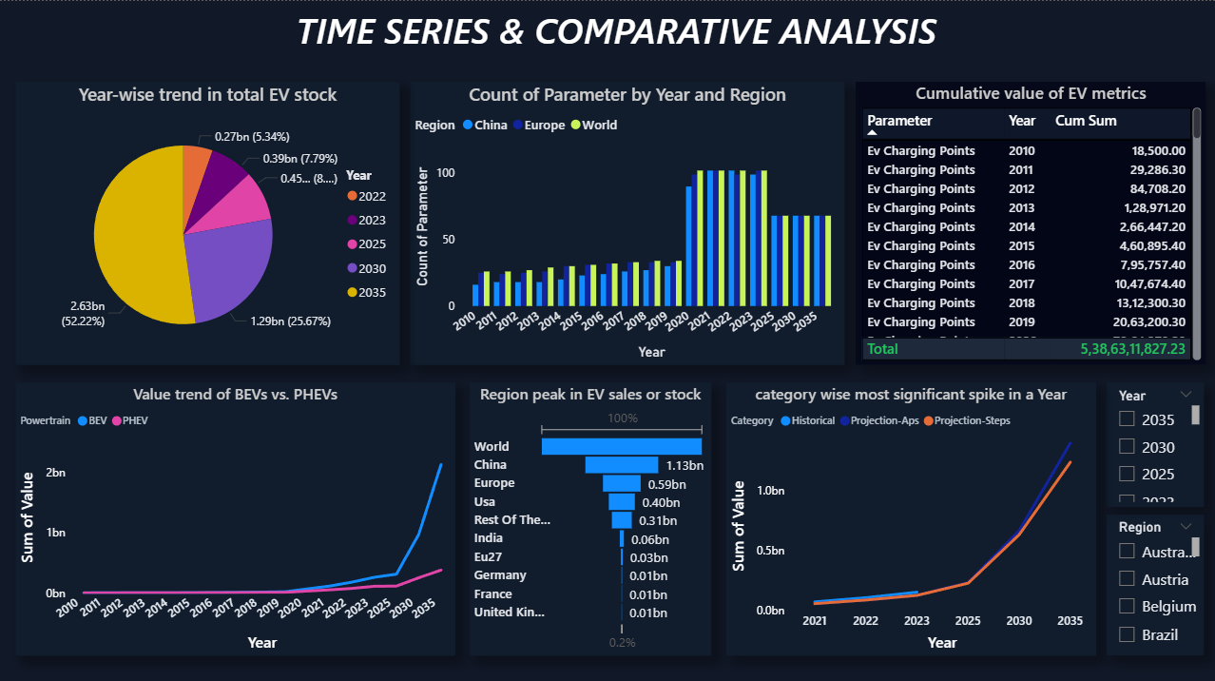
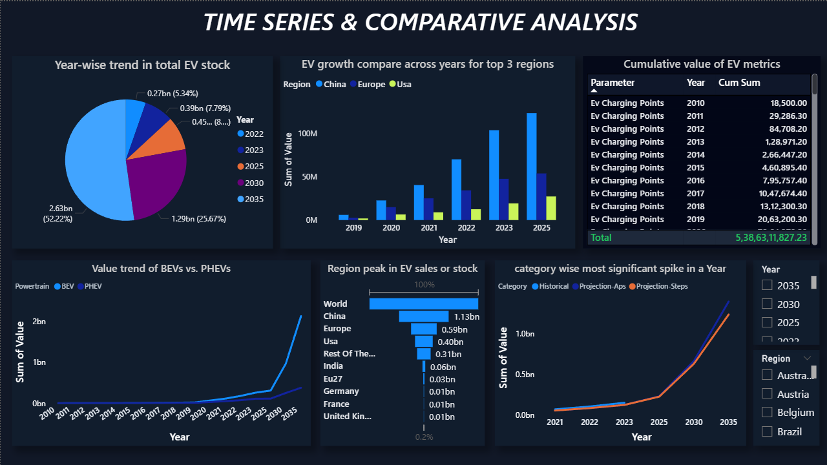


Slide 10
Key Insights :
China is the largest contributor, accounting for more than half of global EV value.
Developing regions show faster growth after 2025, indicating future market potential.
BEVs are the fastest-growing powertrain, showing a clear shift toward fully electric vehicles
EV stock and EV sales are the most frequently tracked performance parameters.
China leads across EV sales, stock, and charging infrastructure, showing ecosystem maturity.
EV adoption accelerates sharply after 2030, highlighting strong future growth expectations.
China, Europe, and the USA show the highest EV peaks, with India emerging as a growth market.

Slide 11
Conclusion :
Electric vehicles are playing an important role in the shift towards cleaner transportation.
The analysis shows that EV adoption is increasing across different regions due to rising awareness, supportive government policies, and improving infrastructure.
Overall, the growing trend of electric vehicles highlights a positive move toward a more sustainable and eco-friendly future.

Slide 12
Recommendations :
Increase the number of public charging stations to make EV usage more convenient.
Encourage affordable EV options to make them accessible to a wider population.
Strengthen government support through subsidies and incentives.
Promote the use of renewable energy for charging electric vehicles.
Improve the quality of the service as we have faced a lot of service issues from the companies in India

Slide 13

THANK YOU

